Slide 1
18 | Clustering models
Stephen F Elston | Principle Consultant , Quantia Analytics, LLC

Slide 2
Overview
Unsupervised learning
k-means clustering
Hierarchical clustering
Evaluation

Slide 3
Unsupervised learning
Define business problem
No labels == no ground truth
Evaluation challenging
What does the structure of the data tell us?
Do different models yield different results?
How many clusters?

Slide 4
Unsupervised Learning
“Unsupervised” means that the training data has no ground truth labels to learn from.
Unsupervised:

Slide 5
Unsupervised Learning
“Unsupervised” means that the training data has no ground truth labels to learn from.
Unsupervised:

Slide 6
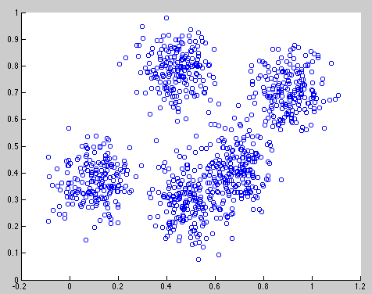
K-Means in action

Slide 7
Hierarchical Agglomerative Clustering
Start with each point in its own cluster
Repeatedly merge the clusters of the closest two points
Notes:
jellyroll

Slide 8
Hierarchical Agglomerative Clustering
Start with each point in its own cluster
Repeatedly merge the clusters of the closest two points
Notes:
jellyroll

Slide 9
Hierarchical Agglomerative Clustering
Start with each point in its own cluster
Repeatedly merge the clusters of the closest two points
Notes:
jellyroll

Slide 10
Hierarchical Agglomerative Clustering
Start with each point in its own cluster
Repeatedly merge the clusters of the closest two points
Notes:
jellyroll

Slide 11
Hierarchical Agglomerative Clustering
Start with each point in its own cluster
Repeatedly merge the clusters of the closest two points
Notes:
jellyroll

Slide 12
Hierarchical Agglomerative Clustering
Start with each point in its own cluster
Repeatedly merge the clusters of the closest two points
Notes:
jellyroll

Slide 13
Hierarchical Agglomerative Clustering
Start with each point in its own cluster
Repeatedly merge the clusters of the closest two points
Notes:
jellyroll

Slide 14
Hierarchical Agglomerative Clustering
Start with each point in its own cluster
Repeatedly merge the clusters of the closest two points
Notes:
jellyroll

Slide 15
Hierarchical Agglomerative Clustering
Start with each point in its own cluster
Repeatedly merge the clusters of the closest two points
Notes:
jellyroll

Slide 16
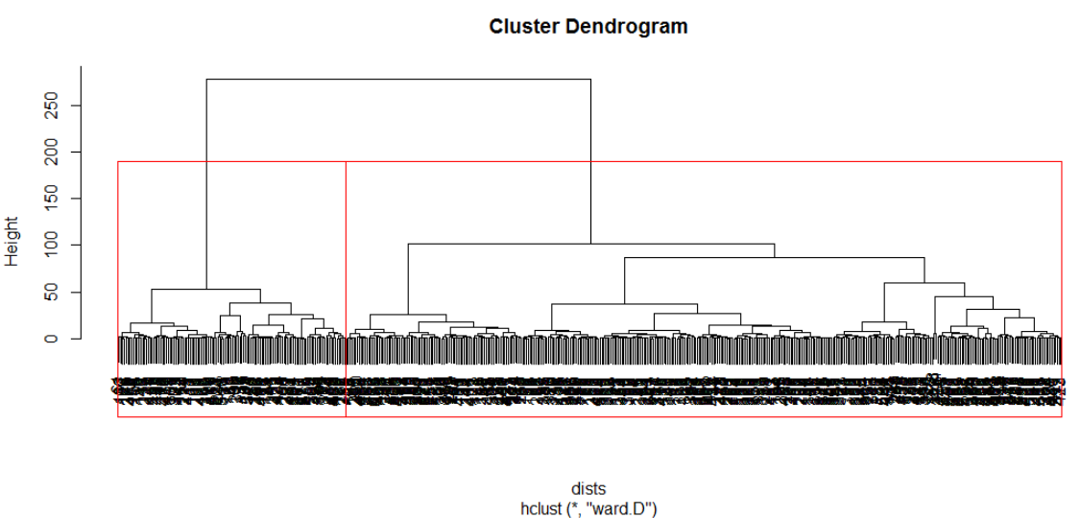
Hierarchical Agglomerative Clustering
Notes:
jellyroll

Slide 17
Evaluation
Are clusters well separated?
Does the structure tell us anything
Summary by principal component projections
Notes:
jellyroll

Slide 18
Principal Component Analysis
Find set of vector projections which explain variance of data
First component
w₍₁₎ = arg max {w^{T} X^{T} X w / w^{T} w}
Dimensionality reduction
T^{(nxq)} = X^{(nxp)} W^{(pxq)} ; where q < p
Notes:
jellyroll

Slide 19
Summary

Slide 20
Overview
Unsupervised learning
k-means clustering
Hierarchical clustering
Evaluation

